Slide 1

WEATHER FORECASTING
Group Members:-
Monalisa 21052910
Aryan Mohanty 21051803
Vishal Banerjee 2105847
Utkal Sahoo 2105846
Samyak Nath 21051333

Slide 2

1.INTRODUCTION
Weather forecasting is the process of predicting the future state of the atmosphere based on analysis of current weather conditions, historical data, and mathematical models of atmospheric dynamics.The primary goal of weather forecasting is to provide accurate information about future weather conditions,including temperature precipitation ,humidity,wind speed and direction,cloud cover and atmospheric pressure.
Following are some of the places where weather forecasting plays a major role:
It aids food grain transportation and storage.
It aids in the handling of cultural operations such as harrowing, hoeing, etc.
Seasons and nature play a major role in agriculture and farming. When it comes to the farming of various fruits, vegetables, and pulses, temperature is extremely important.

Slide 3

1.2 Why we need it:
Risk Mitigation: Weather forecasts help individuals and communities prepare for and mitigate the impacts of adverse weather conditions, such as storms, hurricanes, floods, heatwaves, and cold snaps.
Public Safety: Weather forecasts play a vital role in public safety by enabling authorities to issue timely warnings and advisories for severe weather events.
Health and Wellbeing: Weather forecasts impact public health and well-being by influencing air quality, temperature extremes, and the spread of infectious diseases.
Agriculture and Food Production: Farmers and agriculturalists rely on weather forecasts to make informed decisions about planting, harvesting, irrigation, fertilization, and pest control.
Transportation and Travel: Weather forecasts are essential for transportation systems, airlines, shipping companies, and commuters. They help anticipate weather-related disruptions, adjust schedules, reroute vehicles, and maintain safety standards, ensuring efficient and reliable transportation services.

Slide 4
2.PROBLEM STATEMENT:-
Current Challenges with accessing weather information:-
Inefficiency :Existing weather information platforms may suffer from inefficiencies in delivering timely and accurate data to users.
Complexity: Some weather sources may present data in a complex manner, making it difficult for users to understand and interpret.
Accessibility: Weather information may not be readily accessible to all users, particularly those in remote or underserved areas.
Reliability: Certain weather sources may lack reliability, leading to inaccuracies in forecasts and updates.
Limited Features: Some weather platforms may lack advanced features or customization options, limiting their usefulness for different user needs.

Slide 5

2.1.How to Overcome?
Improving Efficiency: Utilize advanced technologies such as AI and machine learning algorithms to enhance data collection and processing.
Simplifying Complexity: Design weather information platforms with user friendly interfaces and intuitive data visualization techniques.
Expanding Features: Incorporate advanced features such as personalized alerts, customizable forecasts and location-specific weather data.
Aryan

Slide 6
3.USER NEEDS AND REQUIREMENTS:-
When working on a project related to weather forecasting using Python, it's essential to understand the user needs and requirements. Here are some key aspects to consider:
1. Accuracy: Users expect accurate weather predictions, as this directly impacts their daily activities and planning. Your forecasting model should strive for high accuracy in predicting weather conditions like temperature, precipitation, wind speed, and humidity.
2. Real-time Updates: Users often require real-time updates on weather conditions. This involves continuously gathering data from weather stations or APIs and updating the forecast accordingly. Implementing live updates or regular refresh intervals is crucial for meeting this requirement.
3. User-Friendly Interface: The project should have a user-friendly interface that allows users to easily access and interpret weather forecasts. This includes graphical representations like charts, maps, and graphs to display weather data in an understandable format.
4. Customization: Users may have specific preferences or areas of interest for weather forecasts. Providing customization options such as location-based forecasts, customizable alerts for severe weather conditions, and personalization features enhances the user experience.

Slide 7
5. Reliability and Availability: The system should be reliable and available whenever users need weather information. This involves ensuring uptime, handling server or API failures gracefully, and providing alternative data sources or fallback mechanisms.
6. Data Sources: Identify and integrate reliable data sources for weather information. This may include public weather APIs, satellite data, historical weather data, and sensor data from weather stations. Ensuring data quality and consistency is critical for accurate forecasts.
7. Forecasting Models: Choose appropriate forecasting models based on the type of weather data and the forecasting horizon (short-term, medium-term, long-term). Common models include statistical methods, machine learning algorithms (e.g., regression, neural networks), and numerical weather prediction model
8. Scalability: Consider scalability to handle varying user loads and data volumes. The system should be able to scale resources dynamically to meet demand spikes during peak usage periods or extreme weather events.
9. Accessibility: Ensure accessibility for users with disabilities by following accessibility standards and guidelines. This includes providing alternative text for images, keyboard navigation support, and screen reader compatibility.
By addressing these user needs and requirements, you can develop a comprehensive and user-centric weather forecasting system using Python.

Slide 8
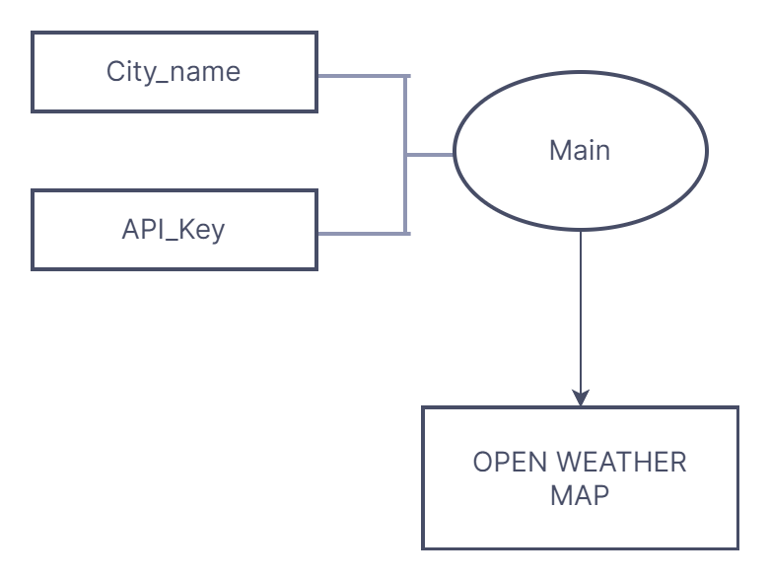
4.DESIGN CONCEPT AND IMPLEMENTATION:-
Concept:-
We have prepared a model which tells about the current weather conditions such as temperature, humidity and description of the city and also gives a graph that depicts the weather prediction of that city for upto 7 days or a week.
Let’s talk about how we have implemented:
1)Function Parameters:
city_name: This parameter represents the name of the city for which weather information is requested.
api_key: This parameter represents your OpenWeatherMap API key, which is necessary to authenticate and access weather data from the OpenWeatherMap API.
2)Building the API Request URL:
The function constructs the API request URL using the base URL, city name, and API key.
The base URL is "http://api.openweathermap.org/data/2.5/forecast?", which is the endpoint for weather forecast data.

Slide 9
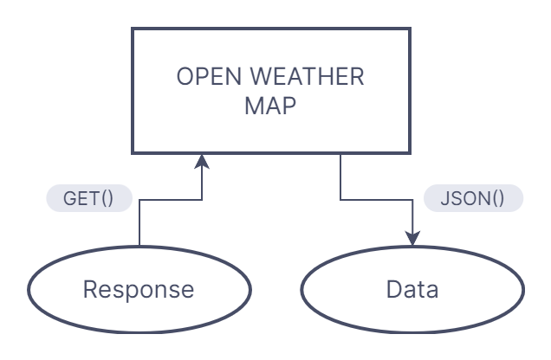
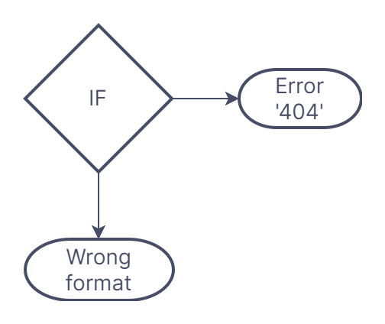
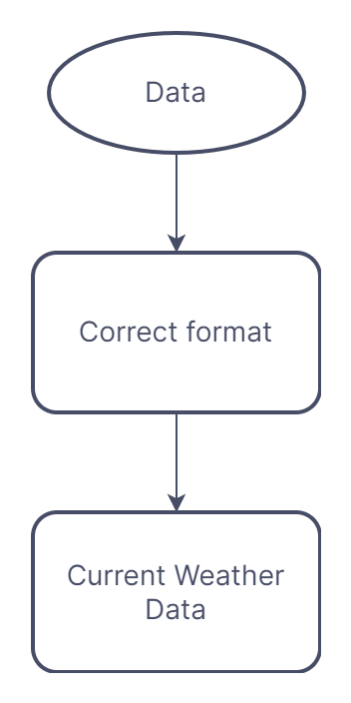
3)Making the API Request:
The function sends a GET request to the OpenWeatherMap API using the constructed URL.
It receives a response, which contains weather forecast data in JSON format.
4)Handling City Not Found:
If the response indicates that the city was not found (code == "404"), the function prints an error message indicating that the city was not found and returns from the function.
5)Parsing Weather Forecast Data:
If the city is found, the function extracts the forecast data from the JSON response.
It retrieves a list of forecasts from the response, each containing information about the weather at a specific time.
6)Extracting Dates and Temperatures:
The function iterates over the list of forecasts and extracts the date and temperature for each forecast.
It converts the date strings to datetime objects using the datetime.strptime() function to facilitate plotting.
7)Extracting Current Weather Information:
The function retrieves the current temperature, humidity, and weather description from the first entry in the forecast data.
This provides the user with immediate weather information before displaying the forecast graph.

Slide 10
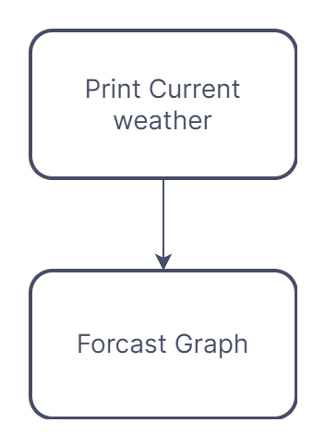
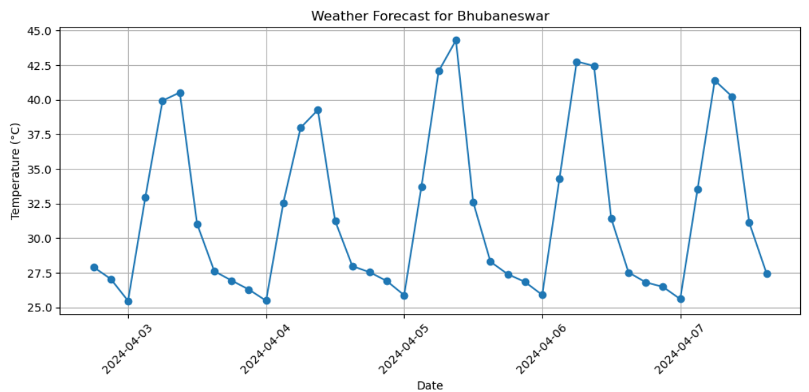
8)Printing Current Weather Information:
The function prints the current weather information, including temperature, humidity, and weather description.
9)Plotting the Forecast Graph:
Finally, the function plots a graph using Matplotlib, showing the temperature trend over the next week.
It sets labels, title, and formatting for the graph before displaying it using plt.show().
This function encapsulates the process of fetching weather data, parsing it, and displaying it to the user, providing both current weather information and a visual representation of the 1-week weather forecast for the specified city.

Slide 11
5.FUTURE SCOPE AND ENHANCEMENTS:-
Weather Prediction Accuracy Improvement:-
• Utilize advanced algorithms and machine learning.
• Incorporate real-time data from satellites, weather stations, IoT devices.
Extended Forecasting Range:-
• Research into atmospheric predictability and modeling techniques.
• Enhancement of seasonal and long-term forecasts due to improved understanding of teleconnections and climate patterns.
UTKAL

Slide 12
Extreme Weather Prediction:-
• Focus on improving forecasts of hurricanes, tornadoes, floods, heatwaves, droughts.
• Enhanced modeling capabilities and understanding of atmospheric dynamics for accurate forecasts and early warnings.
Predictive Analytics and Machine Learning in Weather Forecasting:-
• Leveraging historical data, user feedback, and sensor data.
• Refining forecasting models and identifying emerging trends.

Slide 13
6.CONCLUSION:-
In conclusion, weather forecasting plays a pivotal role in modern society across various sectors and aspects of daily life. By leveraging advanced technologies, observational data, mathematical models, and meteorological expertise, weather forecasting provides valuable insights into future weather conditions, enabling individuals, businesses, and governments to make informed decisions and take proactive measures to mitigate risks, ensure safety, and enhance resilience.

